Slide 1
Vector Addition

Slide 2
What is a Vector
A vector is a value that has a magnitude and direction
  Examples
    Force
    Velocity
    Displacement
A scalar is a value that has a magnitude.
  Examples
    Temperature
    Speed
    Distance

Slide 3
Vector Representation
A vector (A) can be represented as an arrow.
Its magnitude is represented by the length of the arrow,
Designated by the un-bolded style of the symbol (A)
A
A
θ_{A}
Its direction is represented by the angle that the arrow points,
Designated normally by a Greek symbol (sometimes with a subscript) (θ_{A})
It is normally measured from the positive X-axis in a Counter Clockwise Manner
The vector can be written as an ordered pair in the following form:
(A, θ_{A})

Slide 4
Graphical Vector Addition
To add two vectors (A and B) together to get a resultant vector (R) all we have to do is draw the first vector (A)
We can see that the new vector (B) is parallel to the original vector as well as the same length
The end of the first vector (A) is where we start to draw the second vector (B)
B
R
B
A
The addition of the two vectors (A + B = R) is the shortest path that connects the beginning of the first vector (A) to the end of the last vector (B).

Slide 5


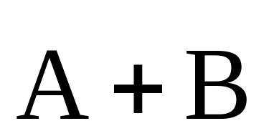
Vector addition – Tip to tail method

Slide 6
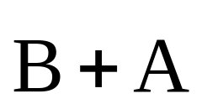
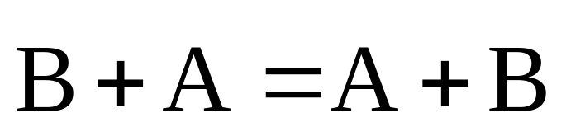
Vector addition – Commutative Law

Slide 7
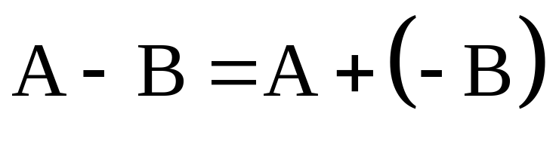

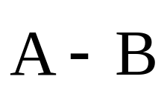
Vector subtraction
Add the negative

Slide 8
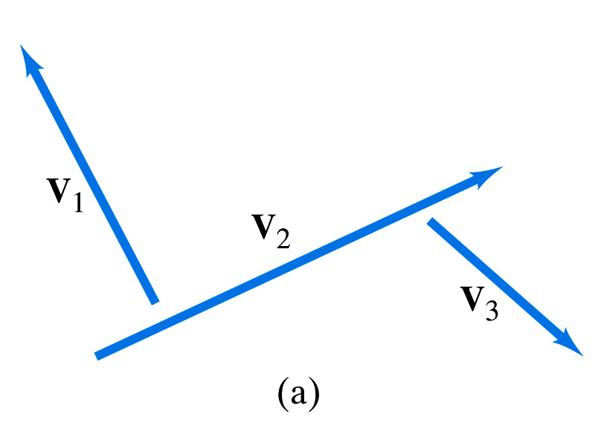
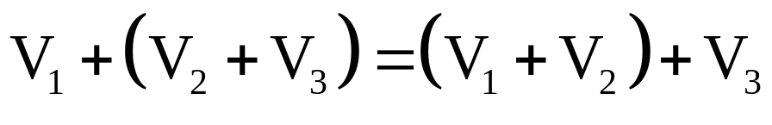
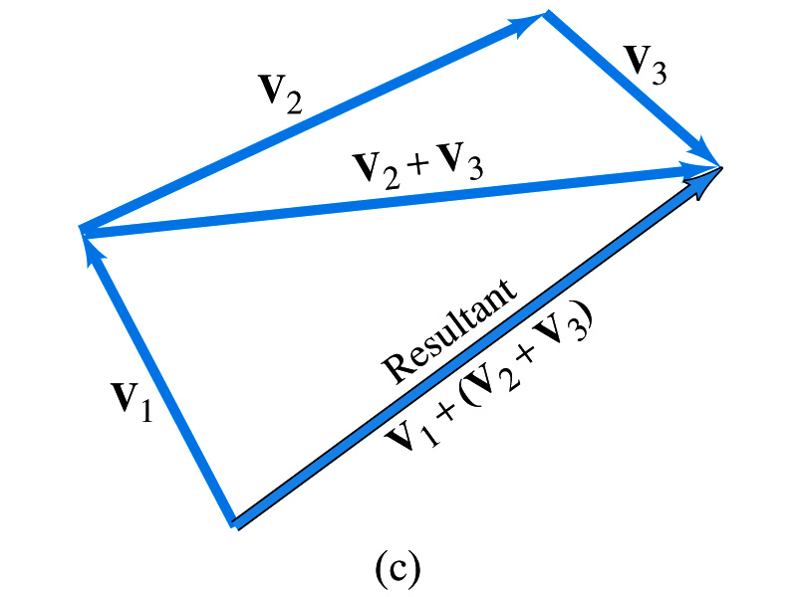
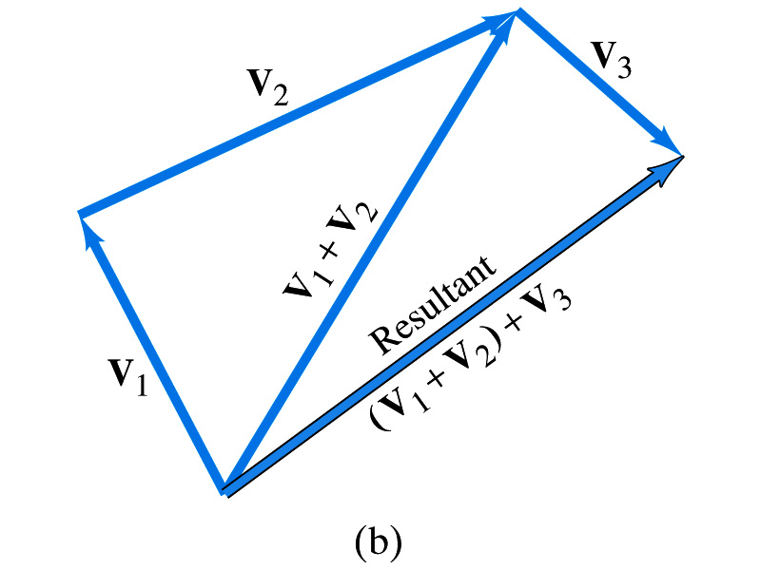
Vector addition
Associative Law

Slide 9
Vector addition
Parallelogram method

Slide 10
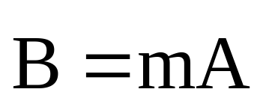

Multiplication of a vector by a scalar
In this case is m greater than or less than 1?

Slide 11
Decomposing a Vector : Part I
Similarly, the y coordinate of the vector (A_{y}) is the projection of the vector (A) onto the x-axis.
Earlier we saw that a vector can be written as a magnitude and an angle (A, θ_{A}). However many times we need it in Cartesian Coordinates (A_{x}, A_{y})
A
A_{y}
Finally, we can see that the x and y coordinates if added together give the original vector.
A_{x}
The x coordinate of the vector (A_{x}) is the projection of the vector (A) onto the x-axis.
A_{x} + A_{y} = A

Slide 12
Decomposing a Vector: Part II
To get the algebraic values for the two components we need to use Trigonometry
Finally to fill out the list we know that:
A_{x}² + A_{y}² = A²
And Pythagorean’s theorem states that:
A
A_{y}
θ_{A}
A_{y}
A_{x}
= Tan (θ_{A})
A_{x}
By using SOHCAHTOA and knowing that we have a right triangle we know that:
A_{x} = A Cos (θ_{A})
A_{y} = A Sin (θ_{A})

Slide 13
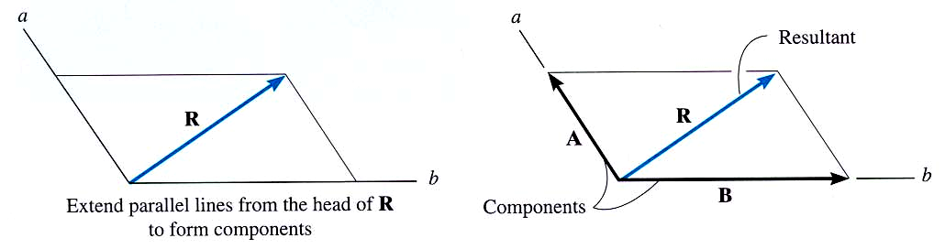
“Resolution” of a vector is breaking up a vector into components. It is kind of like using the parallelogram law in reverse.
RESOLUTION OF A VECTOR

Slide 14
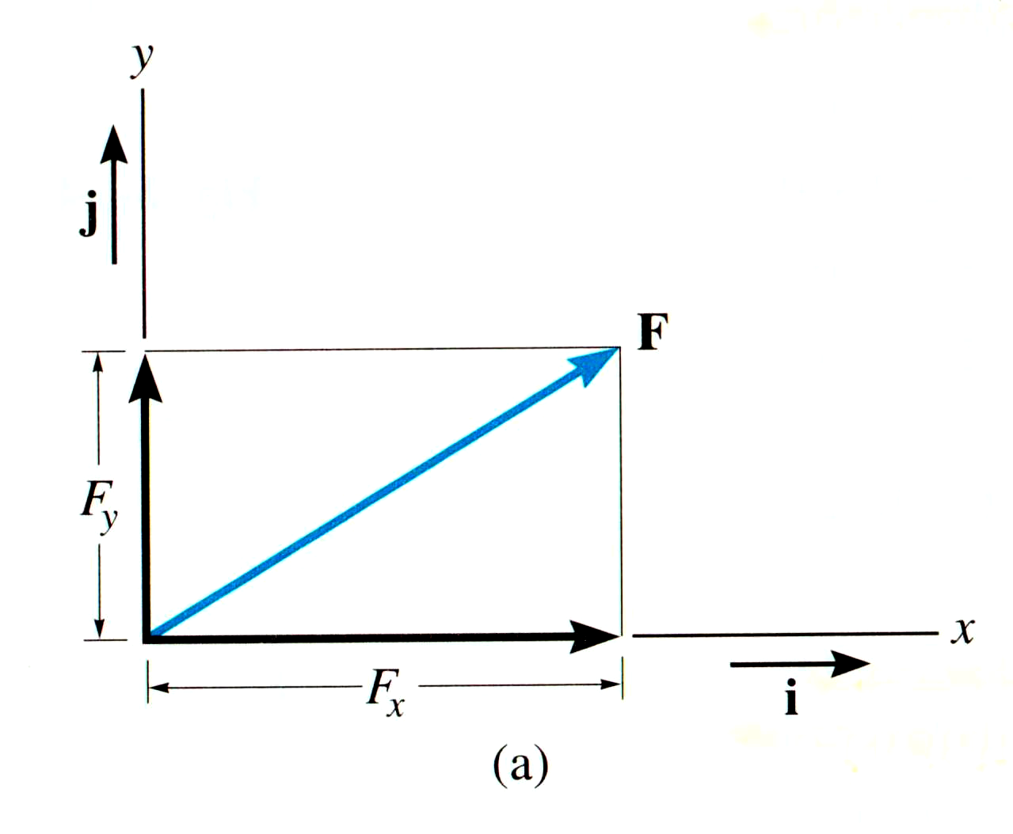
CARTESIAN VECTOR NOTATION
We ‘ resolve’ vectors into components using the x and y axes system
Each component of the vector is shown as a magnitude and a direction.
The directions are based on the x and y axes. We use the “unit vectors” i and j to designate the x and y axes.

Slide 15
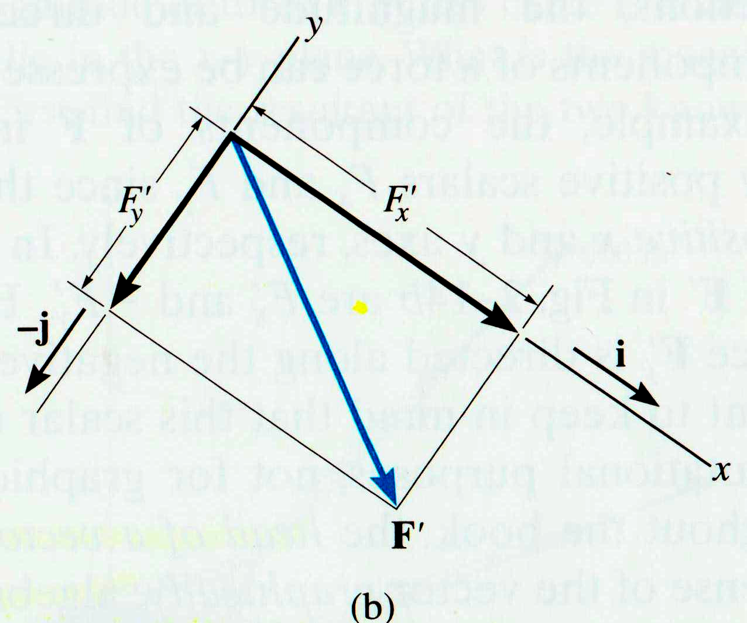
CARTESIAN VECTOR NOTATION
For example,
F = F_{x} i + F_{y} j or F' = F'_{x} i + F'_{y} j
The x and y axes are always perpendicular to each other. Together,they can be directed at any inclination.

Slide 16
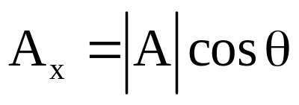
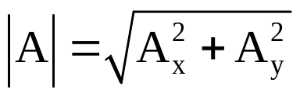

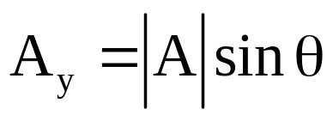
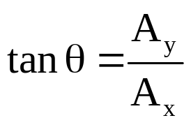


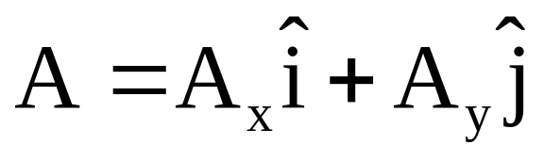
Components of a vector
y
x
Using unit vectors:

Slide 17
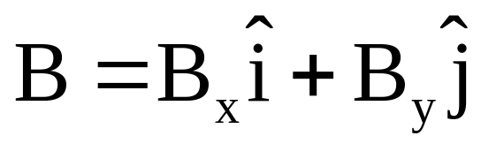
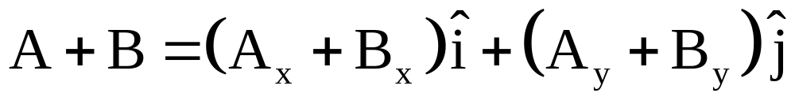
Vector Addition using components

Slide 18
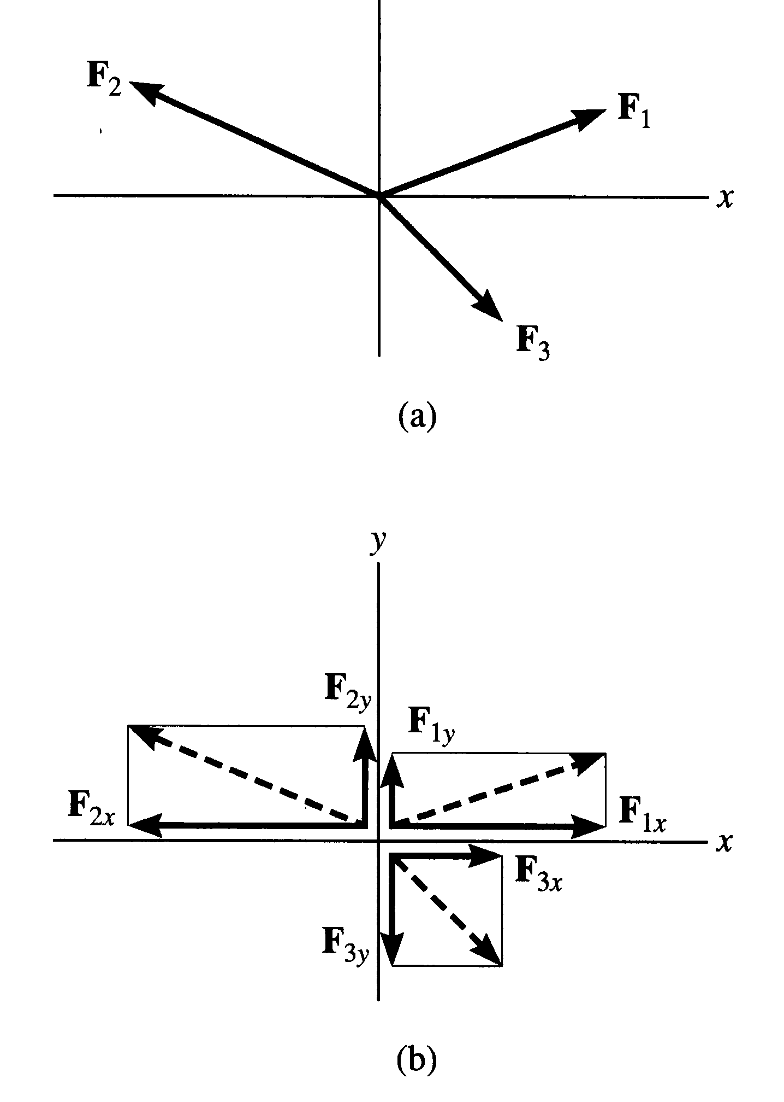
ADDITION OF SEVERAL VECTORS
Step 1 is to resolve each vector into its components
Step 2 is to add all the x components together and add all the y components together. These two totals become the resultant vector.
Step 3 is to find the magnitude and angle of the resultant vector.

Slide 19
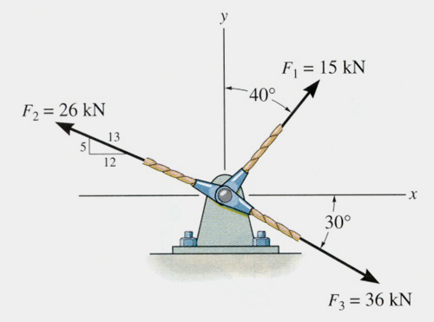
EXAMPLE
Given: Three concurrent forces acting on a bracket.
Find: The magnitude and angle of the resultant force.
Plan:
a) Resolve the forces in their x-y components.
b) Add the respective components to get the resultant vector.
c) Find magnitude and angle from the resultant components.

Slide 20
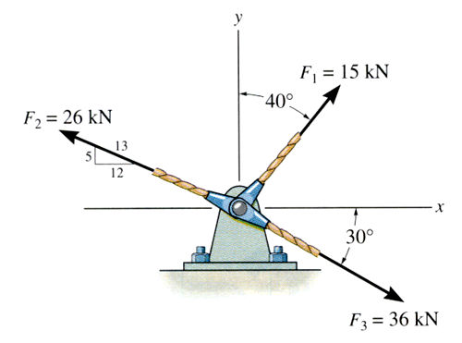
EXAMPLE (continued)
F₁ = { 15 sin 40° i + 15 cos 40° j } kN
= { 9.642 i + 11.49 j } kN
F₂ = { -(12/13)26 i + (5/13)26 j } kN
= { -24 i + 10 j } kN
F₃ = { 36 cos 30° i – 36 sin 30° j } kN
= { 31.18 i – 18 j } kN

Slide 21
EXAMPLE (continued)
Summing up all the i and j components respectively, we get,
F_{R} = { (9.642 – 24 + 31.18) i + (11.49 + 10 – 18) j } kN
= { 16.82 i + 3.49 j } kN
y
F_{R}
F_{R} = ((16.82)² + (3.49)²)^{1/2} = 17.2 kN
φ = tan⁻¹(3.49/16.82) = 11.7°
φ
x

Slide 22
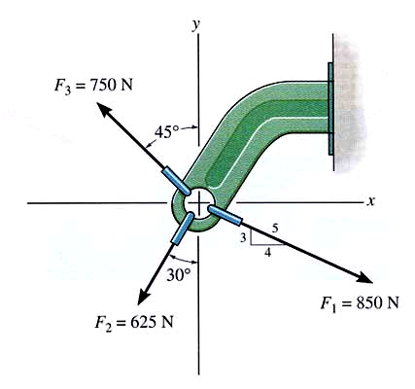
Example
Given: Three concurrent forces acting on a bracket
Find: The magnitude and angle of the resultant force.
Plan:
a) Resolve the forces in their x-y components.
b) Add the respective components to get the resultant vector.
c) Find magnitude and angle from the resultant components.

Slide 23
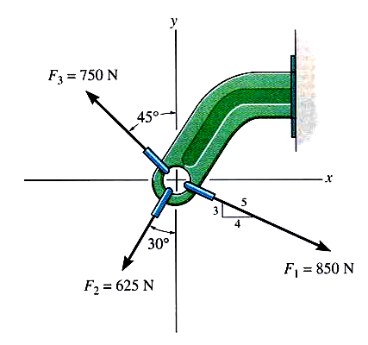
Example (continued)
F1 = { (4/5) 850 i - (3/5) 850 j } N
= { 680 i - 510 j } N
F₂ = { -625 sin(30°) i - 625 cos(30°) j } N
= { -312.5 i - 541.3 j } N
F₃ = { -750 sin(45°) i + 750 cos(45°) j } N
{ -530.3 i + 530.3 j } N

Slide 24
EXAMPLE (continued)
Summing up all the i and j components respectively, we get,
F_{R} = { ((4/5) 850 – 312.5 + 530.3 ) i + (-(3/5) 850 – 541.3 + 530.3) j } N
= { 897.8 i – 521 j } N
y
F_{R}
F_{R} = ((897.8)² + (-521)²)^{1/2} = 1038 N
φ = tan⁻¹(-521/897.8) = -30.1°
φ
x

Slide 25
Steps for vector addition
Select a coordinate system
Draw the vectors
Find the x and y coordinates of all vectors
Find the resultant components with addition and subtraction
Use the Pythagorean theorem to find the magnitude of the resulting vector
Use a suitable trig function to find the angle with respect to the x axis
y
x

Slide 26
SCALARS AND VECTORS
Scalars Vectors
Examples: mass, volume force, velocity
Characteristics: It has a magnitude It has a magnitude
(positive or negative) and direction
Addition rule: Simple arithmetic Parallelogram law
Special Notation: None Bold font, a line, an
arrow or a “carrot”

